Slide 1
inferring the infection pathway of influenza

Slide 2
background

Slide 3
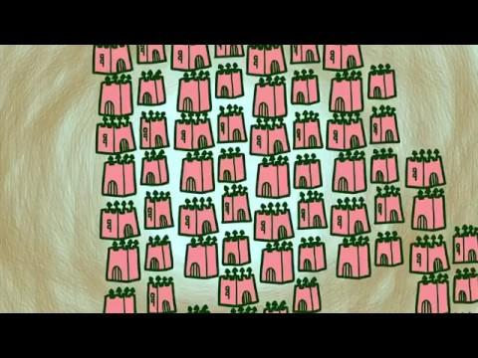
our yearly fight against the flu

Slide 4
our yearly fight against the flu
culprit: Influenza virus (we call subtypes of influenza viruses: strains)
police: white blood cells; antibodies
help: vaccines

Slide 5
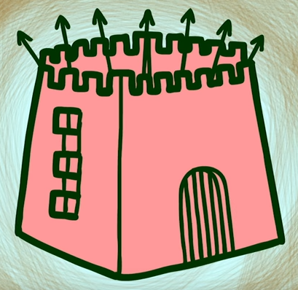

0. our body’s host cells are a fortress,
and the virus is an invader (antigen)
host cell
virus invades

Slide 6
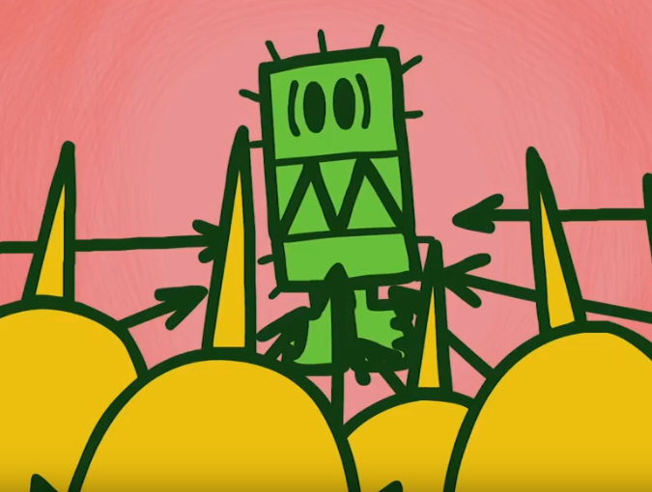
1. when a virus comes in, we need to first recognize that its an invader (antigen)

Slide 7
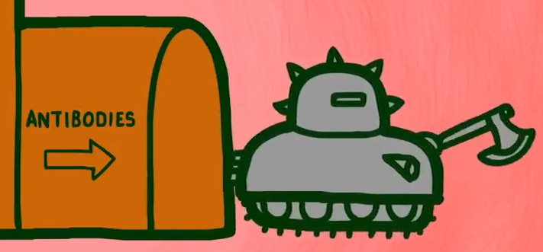
1. when a virus comes in, we need to first recognize that its an invader (antigen)
I… I think he’s a virus
Look… an antibodies found a virus... kill?

Slide 8
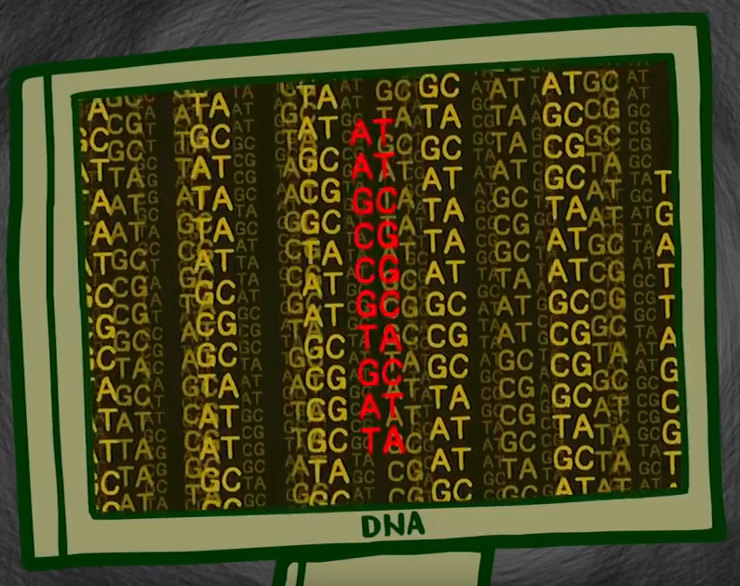
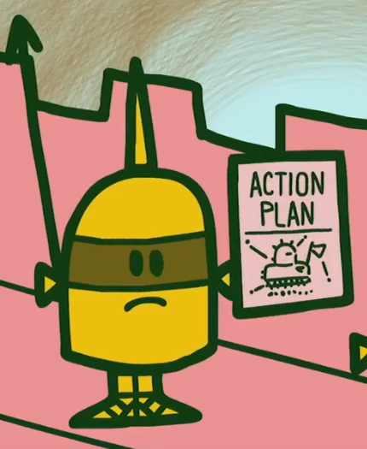
2. after we’ve realized that viruses are invaders, we create antibodies to tell everyone
make custom antibodies to track invading viruses
I… I think he’s a virus
cell recognize virus as invader
Look… an antibodies found a virus... kill?

Slide 9
2. after we’ve realized that viruses are invaders, we create antibodies to tell everyone
make custom antibodies to track invading viruses
We’ve found a virus!
cell recognize virus as invader
Look! Antibodies found a virus! Kill!

Slide 10
how can we speed up this recognition process?
?
make custom antibodies to track invading viruses
host cell
virus invades
cell recognize virus as invader

Slide 11

3. we show our bodies vaccines: a non-functional version of the virus before we are invaded, so that our bodies can make lots of antibodies in advance!
which virus will survive till next year?

Slide 12
3. we show our bodies vaccines: a non-functional version of the virus before we are invaded, so that our bodies can make lots of antibodies in advance!
survivor

Slide 13
3. we show our bodies vaccines: a non-functional version of the virus before we are invaded, so that our bodies can make lots of antibodies in advance!
survivor
cell recognize virus as invader

Slide 14
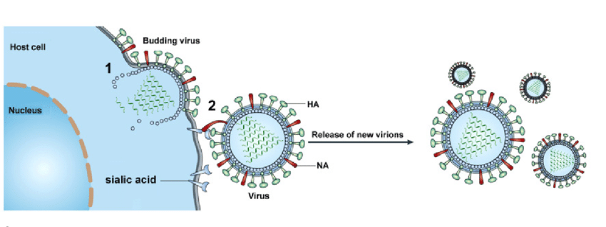
so how does it actually look?
Host Cell
virus invades
RNA

Slide 15
so how does it actually look?
RNA

Slide 16
so how does it actually look?
RNA

Slide 17
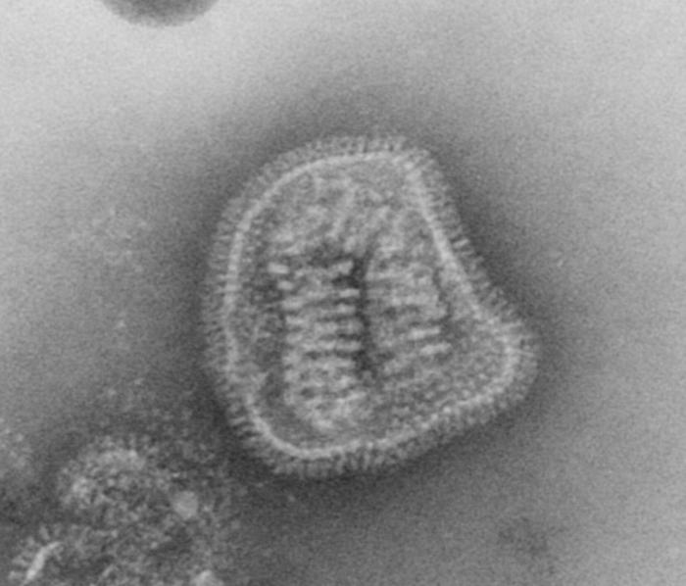
so how does it actually look?
RNA

Slide 18
how can AI help us fight against the flu?
infer the past: infer ancestral virus strains (ancestors of modern day flu virus) so that we can understand how the flu is spreading, and visualize where the flu will go next
infer the future: infer future virus strains so that we can develop vaccines to guard people against the next flu season

Slide 19
Definitions

Slide 20
genetic sequence
“a genetic sequence is a list of letters or nucleotides on a strand of DNA (made up of ACGT) or RNA (ACGU) molecule”; it defines who we are… and who they are!
ACGUAAGUUUUGUAUGU …

Slide 21
genetic sequence
“a genetic sequence is a list of letters or nucleotides on a strand of DNA (made up of ACGT) or RNA (ACGU) molecule”; it defines who we are… and who they are!
ACGUAAGUUUUGUAUGU …
ACGUAGGUUUUGUAUGU …
evolution!

Slide 22
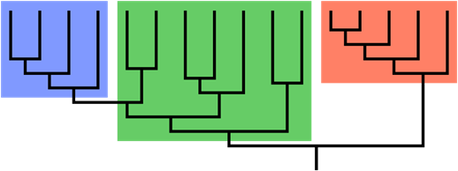
phylogenetic tree
“a phylogeny, phylogenetic tree, or evolutionary tree is a branching diagram or "tree" showing the evolutionary relationships among various biological organisms (i.e. different strains of influenza virus) based on similarities and differences in their physical or genetic characteristics (i.e. genetic sequences)”
evolution!
influenza virus

Slide 23
clade
“a clade in a phylogenetic tree is a group of organisms that consists of a common ancestor and all its descendants, and represents a single branch on the phylogenetic tree”
subtype of influenza virus

Slide 24
strain
“a strain is a low-level taxonomic rank used at the intraspecific level (within a species)”
a strain of influenza virus

Slide 25
let’s make our phylogeny!

Slide 26
to make our phylogeny, we use the sequences of our influenza virus strains and a couple of methods
data:
FASTA.fa: we use influenza subtype A/H3N2 genetic sequences from years 1997 - 2017 (n = 10370), in particular the HA gene
alignment.fa: we aligned FASTA.fa using MAFFT, a multiple sequence alignment program
tree: we use the RAxML (maximum likelihood) method to obtain our phylogenetic tree

Slide 27
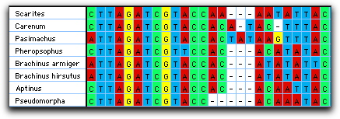
1. we conduct multiple sequence alignment MAFFT
Multiple Sequence Alignment (MSA) is generally the alignment of three or more biological sequences (protein or nucleic acid) of similar length.
MAFFT
we use MAFFT which is suitable for medium-large alignments.

Slide 28
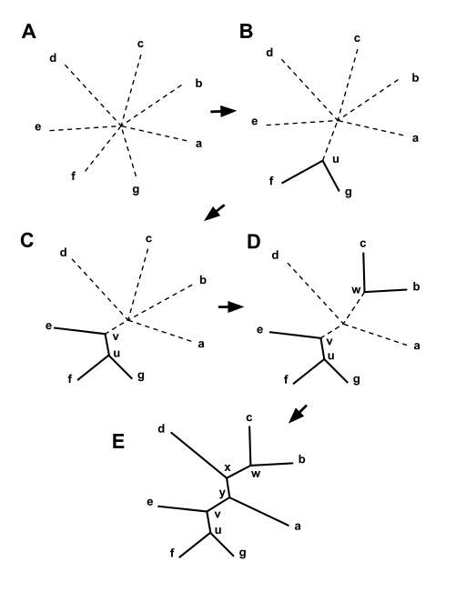
2. given the alignments, we can infer the phylogeny
Neibour Joining:
The input is a distance matrix D, specifying the distance between each pair of strains (taxa).
2. Calculate an axillary matrix Q, based on D as follows:
3. Find the pairs i and j such that the value of Q(i , j) has its lowest value.
These taxa are joined to a newly created node and form a cherry.
4. Calculate the distance from each of the taxa to the new node.
5. Start the algorithm again, use the distances computed in the previous step
and replace the pair of joined neighbors with a new node.
UPGMA:
Parsimony:
Maximum Liklihood:
Baysian Method:

Slide 29
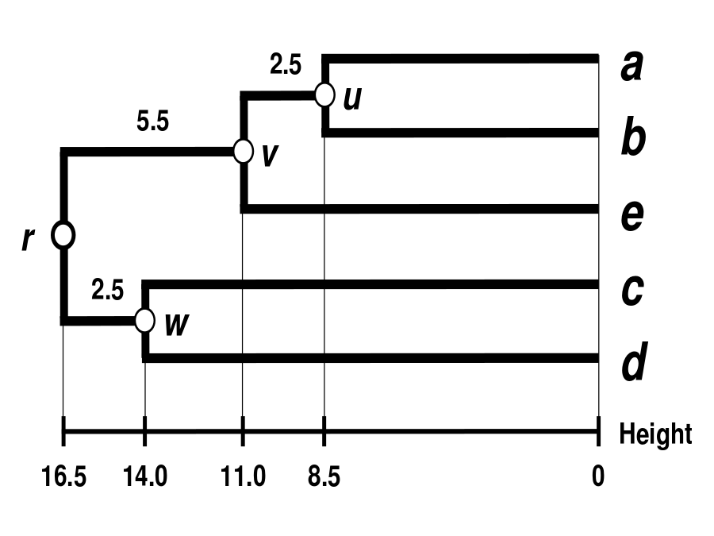
2. given the alignments, we can infer the phylogeny
UPGMA (Unweighted Pair Group Method with Arithmetic Mean)
The UPGMA algorithm constructs a rooted tree that reflects the structure present in a distance matrix. At each step, the nearest two clusters are combined into a higher-level cluster. The distance between any two clusters A and B each of size is taken to be the average of all distances between pairs of objects in A and B, that is, the mean distance between elements of each cluster.
The UPGMA algorithm produces rooted tree and it assumes an ultrametric tree in which the distances from the root to every branch tip are equal.

Slide 30
2. given the alignments, we can infer the phylogeny
Maximum Parsimony
A procedure to find the minimum number of changes needed to explain the data for a given tree topology, where species are assigned to leaves. (Small Parsimony Problem)

Slide 31
2. given the alignments, we can infer the phylogeny
Maximum Liklihood
Maximum likelihood is a commonley used method to build trees.
Likelihood provides probabilities of the sequences given a model of their evolution on a particular tree.
The more probable the sequences given the tree, the more the tree is preferred.
All possible trees are considered; computationally intense.

Slide 32
infer the past
ancestral sequence reconstruction

Slide 33

once we have a phylogeny tree,
we want to know who the ancestors of our current strains are so we would know how the flu spread
© J.Dutheil

Slide 34
once we have a phylogeny tree,
we want to know who the ancestors of our current strains are so we would know how the flu spread
Known strains
Unknown ancestral strains
© J.Dutheil

Slide 35
once we have a phylogeny tree,
we want to know who the ancestors of our current strains are so we would know how the flu spread
Known strains
Unknown ancestral strains
© J.Dutheil

Slide 36

once we have a phylogeny tree,
we want to know who the ancestors of our current strains are so we would know how the flu spread
Known strains
Unknown ancestral strains
Inferred using maximum parsimony
© J.Dutheil

Slide 37
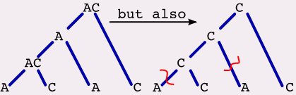
once we have a phylogeny tree,
we want to know who the ancestors of our current strains are so we would know how the flu spread
Known strains
Unknown ancestral strains
Inferred using maximum parsimony
© J.Dutheil

Slide 38
once we have a phylogeny tree,
we want to know who the ancestors of our current strains are so we would know how the flu spread
Known strains
Unknown ancestral strains
Inferred using maximum parsimony
Choosing between the different options: ACCTRAN = ”ACCelerates the evolutionary TRANsformation of a character, pushing it down the tree as far as possible.”
© J.Dutheil

Slide 39
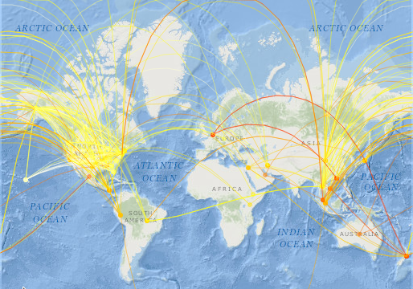
now that we have inferred the ancestral sequences, let’s match them up with known strains, so we can see how the flu spread!

Slide 40
infer the future
predicting the evolution of the influenza virus using topological phylogenetic properties

Slide 41
seeing how the flu will spread is great, next let’s predict which strains will cause next season’s flu!
i.e. which strain will persist into the future given a specified period of time
hypothesis:
only fit influenza strains will persist to cause the next season of influenza outbreak; this fitness affects features of clade structure and branching patterns (including timing), and this information can be extracted using machine learning tools
therefore, a successful strain or internal node would be at the root of this clade and current strains with high fitness are likely to be the leaves of the successful clade .

Slide 42
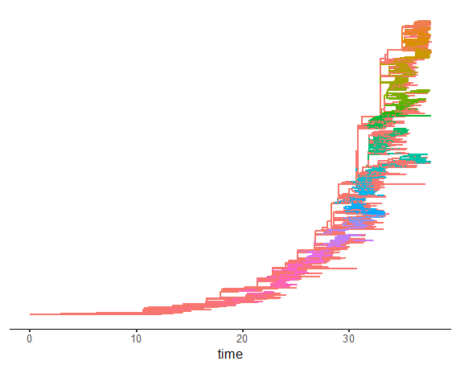
knowing that, let’s start with clade extraction

Slide 43
knowing that, let’s start with clade extraction
and feature extraction
we assign a vector of 25 features to each clade and build our prediction models based on these feature vectors; the phylogenetic properties that we use as our feature vector or predictors are:
Tips, sackin, colless, Variance, I2, B1, B2, avgLadder, Ilnumber, pitchforks, maxHeight, MaxWidth, DelW, Stairs1, Stairs2, Cherries, BS, MeanPairwiseDist, MaxPairwiseDist, diameter, WienerIndex, betweenness, closeness, eigenvector

Slide 44
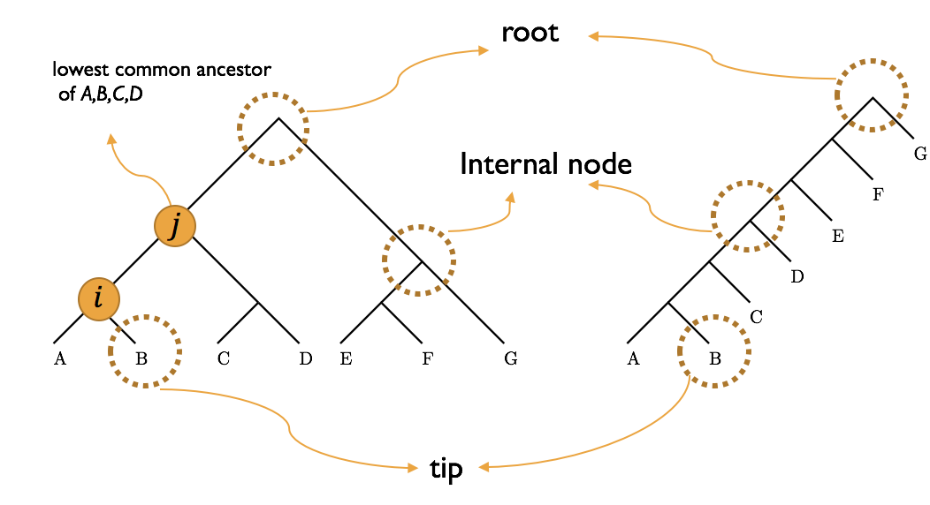
Tree Shape Statistics
Tip (External node, leaf)
Internal node
lowest common ancestor:
The lowest common ancestor between two nodes is defined
as the lowest node in T that has both n1 and n2 as descendants
Depth:
The depth of a node is the number of edges from the
root to the node.
Height: The height of a node is the number of edges from the node to the deepest leaf.

Slide 45
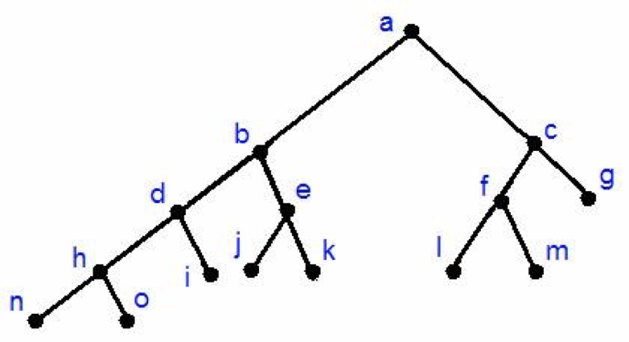
Tree Shape Statistics
Cherry number
Pitchforks
Clades of size x
Maximum ladder

Slide 46
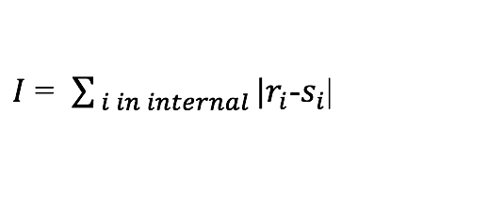
Tree Shape Statistics
Colless imbalance is the sum of absolute values |r-s| for all internal nodes, where r and s are the numbers of leaves in the left and right subtree of a node, respectively

Slide 47
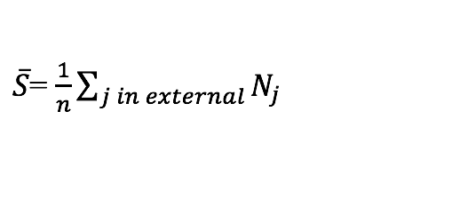
Tree Shape Statistics
The Sackin index is the average path length from a leaf to the root of the tree

Slide 48
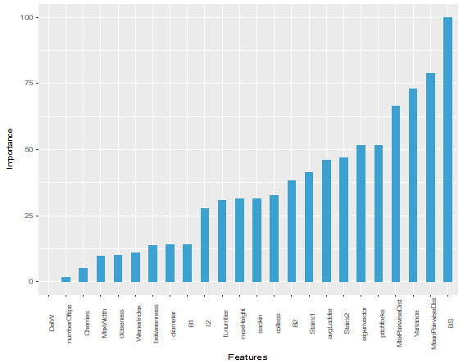
knowing that, let’s start with clade extraction
and feature extraction

Slide 49
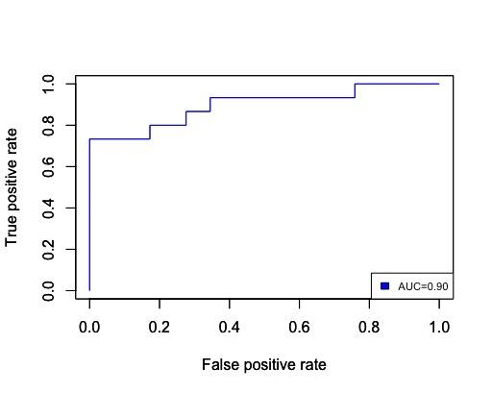
using those features, we train our classifier, SVM with radial kernel; the results:

Slide 50
we did it!
In this presentation, we learned how to:
use influenza genetic sequences to infer a phylogeny, or evolutionary tree of the influenza virus
use the phylogeny to infer ancestral influenza strains to understand how the flu is spread
use the phylogeny to predict future persisting influenza strains to help with development of vaccines

